Slide 1
Team Unified
Collate My Social Feed (Digilabs Project)
By Kasim, Zain, Tiffany, Keir, Dominik
Notes:
Introduce our roles

Slide 2
Our project
The title of our project is ‘Collate My Social Feed’.
Our main objective is to work with our live client to create a hybrid-native mobile application that will fetch a users social media entries from multiple supported networks and display them in a unified feed.
Using this app users can use one application to view their social feed in a clean and simple way rather than switching between multiple apps to find their daily social feed.

Slide 3
Our interpretation of the brief
The user should be able to connect/authenticate multiple accounts from each platform supported and view their feeds chronologically in a standardised format.
By default the app will display both text along with an image (alt if no image is found in that post), however the user will be able to further refine their experience by:
Selecting between what networks are shown in the feed
Search for a keyword to base the content of the feed on
Specific time period from which posts are shown
User can click on each post and it will open within the web browser on the social networks site allowing for commenting, liking and sharing etc.
To achieve this, we must build plugin functionality for one social network and build on that to add additional enhancements / features to other providers we support or find any native functionality and implement this through the frameworks we are going to be using.
Notes:
The user should be able to connect and authenticate multiple accounts from each platform supported and view their feeds chronologically in a standardised format, which by default will display both text and an image, however the user will be able to refine their experience by selecting between UI’s or altering the time period from which posts are shown.
To achieve this, we must build a plugin functionality for each social network or find any native functionality and implement this through Cordova.

Slide 4
What are we going to do to solve the problem, and when?
Planning, Designing, Investigating , Implementing.
To create a working application we need to take into consideration that this is a big project and we don’t have a huge amount of time to do it (time constrained) so we need to layout the project in an appropriate manner to minimise problems that could occur within the project’s life-cycle that are too late to fix.
Delegate workload across the group, having deadlines where things are done by so we can keep the project on schedule while moving towards the end goal of a finished project.
That in the end we can present to the client a working and functional product that meets all their wants and needs.

Slide 5
What will we need to learn to put our plans into action, and how?
In order to put our plans into action we need to research what sort of software we would need to use in order to create our collated social media app.
First of all we need to decide on a 3rd party cordova plugin that handles the problem with connecting and retrieving data from a social network provider. Ng-Cordova-Oauth solves this problem, while it did support all the social networks we wished to add, it has since been blocked by some some providers (Google) and doesn’t work with others anymore (Twitter).
Reddit, Instagram, Facebook and LinkedIn are the only supported platforms for now.
In addition, we will be using cross platform technologies such as Ionic v1, angular.js and Cordova native plugins this will allow us to create our app using HTML, CSS and JS and then converting to a native application using the platforms native SDK.
We will be using frameworks that some of us may have never used before, even though we may be proficient in HTML, CSS and JS.
Notes:
- Tiff

Slide 6
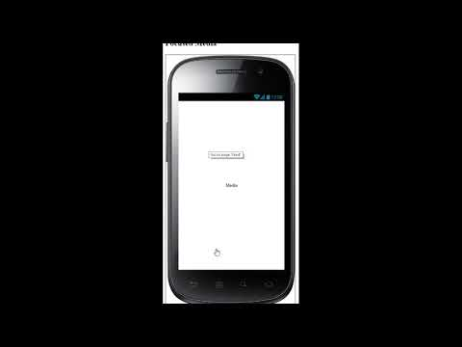
Wireframe Prototype

Slide 7
What could go wrong?
Things we can control
Running out of time (Budget)
Poor planning
Unclear Goals / Objectives
Uneven distribution of work between group members
Use of new technologies
Poor Communication (between team and client, or just within the group)
Things we can’t control
Cordova-Oauth plugin support (Outdated Plugins)
Unplanned absences
Personal issues
What information we can pull all of the different supported API’s
Computer Problems

Slide 8
Summary
We have been asked to create a hybrid-native app which fills the void between having multiple apps and combines that into one simple app, it will allow for authentication with multiple platforms and accounts from the same provider (using frameworks such as angularjs, ionic v1 and cordova native plugins).
Displaying them in one unified feed within customizable options such as hiding and showing certain social networks on demand, searching for a specific keyword which in turn pulls necessary data matching the keyword, UI theming. If the user wishes to comment or do anything else they can click the post and it will take them to that post within the web browser.

